Slide 1
Graphing Reactions

Slide 2
Reaction Mechanism
Steps to completing a reaction
Converting reactants to products
Requires favorable collisions between molecules

Slide 3
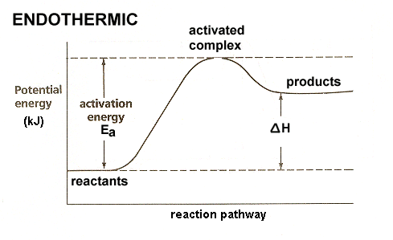
Graphing Reaction Mechanisms
When molecules react
Intermediate products are called the activated complex
Activation energy- minimum amount of energy needed to form intermediates

Slide 4
Potential Energy Diagrams
X axis- time (progress of reaction)
Y axis- potential energy
ΔH – enthalpy (heat of the reaction= energy absorbed or released)
ΔH = Energyproducts – Energy reactants

Slide 5
Endothermic reaction
Products have more energy than reactants
Energy is absorbed to make the product
ΔH (enthalpy) is positive

Slide 6
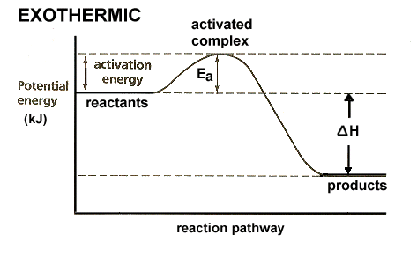
Exothermic reaction
Reactants have more energy than products
Energy is released to make the product
ΔH (enthalpy) is negative

Slide 7
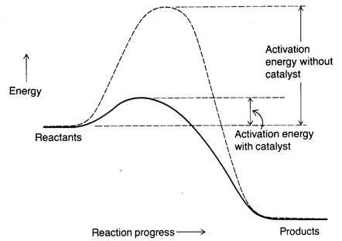
Reaction Mechanism with a Catalyst
Catalysts (enzymes) decrease activation energy
Increase rate of reaction

