Slide 1
DNA Technology Review

Slide 2
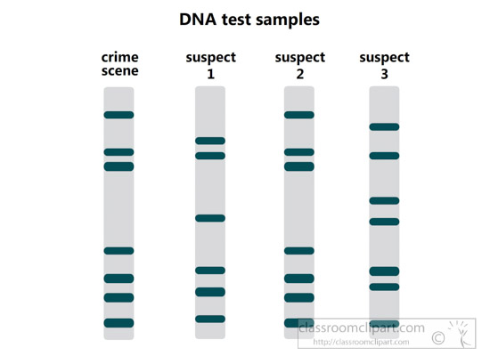
A) What is this an image of?
B) Which of the suspects committed the crime?
C) Where are the largest pieces of DNA located?
D) Which side of the gel is positive?
E) Why are the bands not the same thickness?
F) What was used to create all the different sized pieces of DNA?

Slide 3
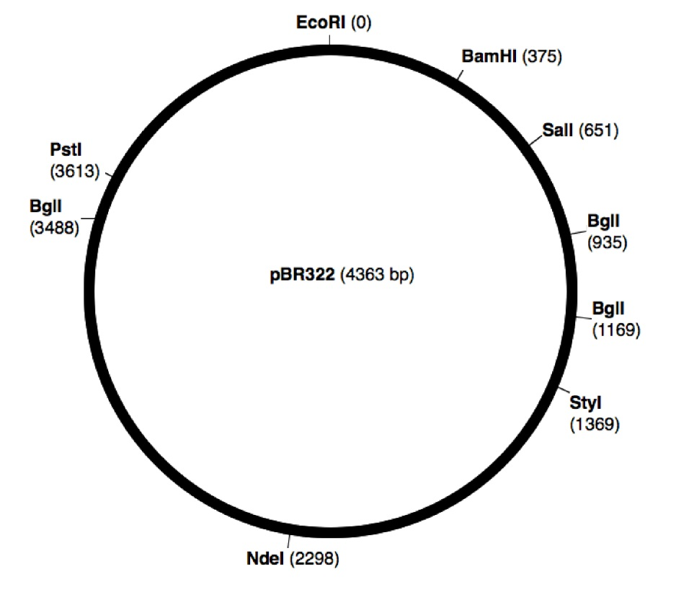
What is the circular structure called?
B)What is BgII an example of?
C)How many pieces of DNA would be created from BgII?
D) Create the DNA fingerprints for PstI, BgII, and EcoRI with BamHI.

Slide 4
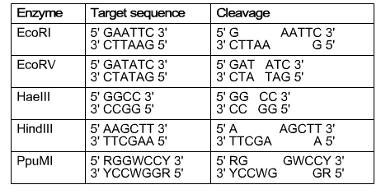
Which enzymes would produce sticky ends?
B) Which enzymes would you want to use to form a transgenic organism?
C) Which enzyme would you want to use to cleave the following sequence 5’AAAGCTTGTGATATC3’?

Slide 5
State the basic procedure/process for each technique:
Gene therapy
Cloning genes
PCR
Transgenic organisms
Genetic engineering
Stem Cells

Slide 6
What is controversial or issue with each of the following techniques?
Gene Therapy
Cloning
PCR
Transgenic organisms
Genetic engineering
Stem cells

Slide 7
Create the restriction map (circle) and DNA fingerprint (rectangle) for the plasmid with the following information:
 | Lengths of Fragments
ABC | 4 , 4
DEF | 3.5, 4.5
ABC and DEF | 1, 1.5, 2.5, 3

