Slide 1
Concentration

Slide 2
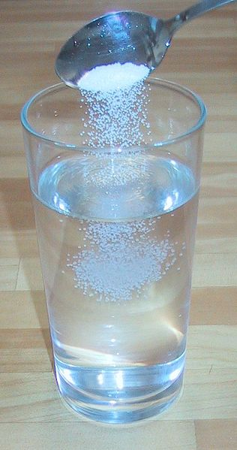
Concentration
Solution
homogeneous mixture
solute dissolved in solvent
Concentration
ratio of the amount of solute to the amount of solvent.
Notes:
A common task in a biotechnology lab is preparing solutions. What exactly is a solution? A solution is a mixture of what is dissolved (the solute) and the dissolving medium (the solvent). For example, if you are making koolaid the colored sugar is the solute and the pitcher of water is the solvent. The concentration of a solution is the ratio of the amount of solute to solvent. It is necessary to prepare solutions with the correct concentration or you can destroy months of hard work in a biotechnology lab.

Slide 3
Molarity (M)
A concentration that expresses the
moles of solute in 1 L of solution
Molarity (M) = moles of solute
1 liter solution

Slide 4
Units of Molarity
2.0 M HCl = 2.0 moles HCl
1 L HCl solution
6.0 M HCl = 6.0 moles HCl
1 L HCl solution

Slide 5
Conversion reminders:
Moles
Grams → moles
Molar mass
Volume
Milliliter → Liter
1000 mL = 1 L

Slide 6
Calculating Molarity
NaOH is used to open stopped sinks, to treat cellulose in the making of nylon, and to remove potato peels commercially. If 4.0 g NaOH are used to make 500. mL of NaOH solution, what is the molarity (M) of the solution?

Slide 7
Calculating Molarity
1) 4.0 g NaOH x 1 mole NaOH = 0.10 mole NaOH
40.0 g NaOH
2) 500. mL x 1 L _ = 0.500 L
1000 mL
3. 0.10 mole NaOH = 0.20 mole NaOH
0.500 L 1 L
= 0.20 M NaOH

Slide 8
Learning Check M1
A KOH solution with a volume of 400 mL contains 2 mole KOH. What is the molarity of the solution?
1) 8 M
2) 5 M
3) 2 M
Drano

Slide 9
Solution M1
A KOH solution with a volume of 400 mL contains 2 moles of KOH. What is the molarity of the solution?
2) 5 M
M = 2 mole KOH = 5 M
0.4 L
Drano

Slide 10
Learning Check M2
A glucose solution with a volume of 2.0 L contains 72 g glucose (C₆H₁₂O₆). If glucose has a molar mass of 180. g/mole, what is the molarity of the glucose solution?
1) 0.20 M
2) 5.0 M
3) 36 M

Slide 11
Solution M2
A glucose solution with a volume of 2.0 L contains 72 g glucose (C₆H₁₂O₆). If glucose has a molar mass of 180. g/mole, what is the molarity of the glucose solution?
1) 72 g x 1 mole x 1 = 0.20 M
180. g 2.0 L

Slide 12
Learning Check M3
Stomach acid is a 0.10 M HCl solution. How many moles of HCl are in 1500 mL of stomach acid solution?
1) 15 moles HCl
2) 1.5 moles HCl
3) 0.15 moles HCl

Slide 13
Solution M3
3) 1500 mL x 1 L = 1.5 L
1000 mL
1.5 L x 0.10 mole HCl = 0.15 mole HCl
1 L
(Molarity factor)

Slide 14
Learning Check M4
How many grams of KCl are present in 2.5 L of 0.50 M KCl?
1) 1.3 g
2) 5.0 g
3) 93 g

Slide 15
Solution M4
3)
2.5 L x 0.50 mole x 74.6 g KCl = 93 g KCl
1 L 1 mole KCl

Slide 16
Learning Check M5
How many milliliters of stomach acid, which is 0.10 M HCl, contain 0.15 mole HCl?
1) 150 mL
2) 1500 mL
3) 5000 mL

Slide 17
Solution M5
2) 0.15 mole HCl x 1 L soln x 1000 mL
0.10 mole HCl 1 L
(Molarity inverted)
= 1500 mL HCl

Slide 18
Learning Check M6
How many grams of NaOH are required to prepare 400. mL of 3.0 M NaOH solution?
1) 12 g
2) 48 g
3) 300 g

Slide 19
Solution M6
2) 400. mL x 1 L = 0.400 L
1000 mL
0.400 L x 3.0 mole NaOH x 40.0 g NaOH 1 L 1 mole NaOH
(molar mass)
= 48 g NaOH

