Slide 1
Temperature & Heat
Chapter 6.1

Slide 2
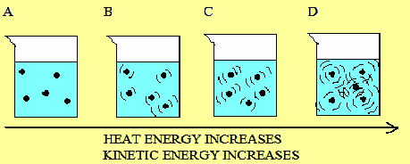
Temperature
Measure of the average kinetic energy of the particles in an object
Higher the temperature, the more the molecules move

Slide 3
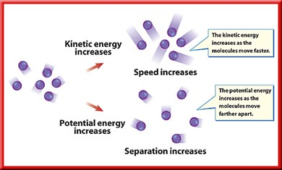
Thermal energy
Sum of the kinetic and potential energy of particles in an object
Determined by the temperature (KE) and the position of the molecules (PE)
Molecules are attracted to each other so when separated they have the potential to move closer to each other

Slide 4
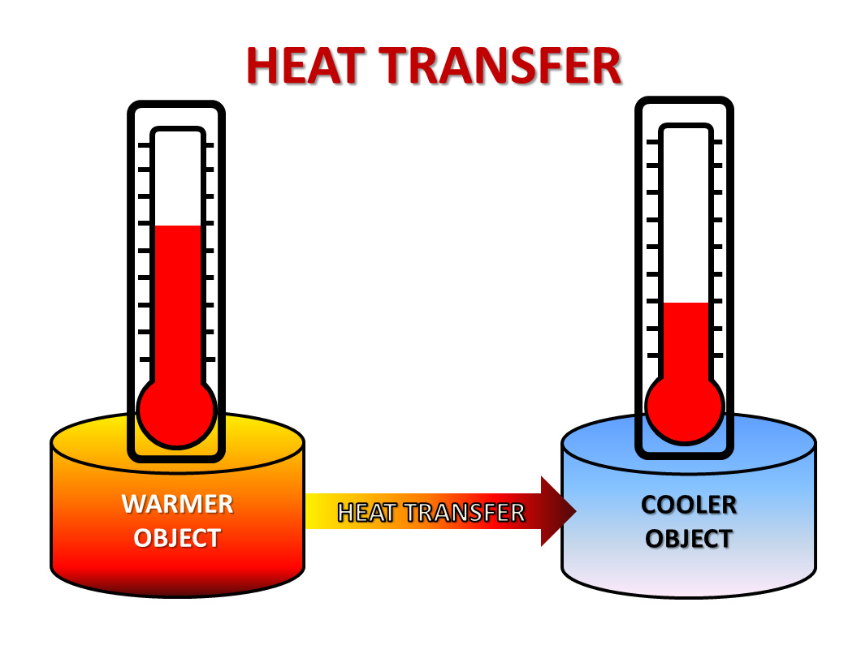
Heat
Thermal energy that flows from something at a higher temperature to something at a lower temperature
Form of energy
Measured in J

Slide 5
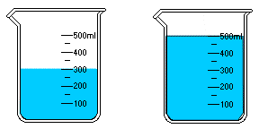
Thermal energy and mass
If an object has more mass, it will have to have more thermal energy than an object less massive to be the same temperature (same average kinetic energy).

Slide 6
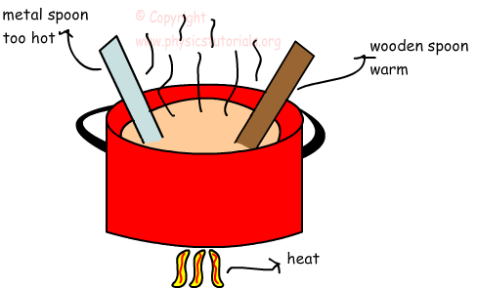
Specific Heat
As a substance absorbs heat, its temperature change depends on the nature of the substance (what it is made of) and how much heat is added.
Specific heat: amount of heat needed to raise the temperature of a 1 kg of a substance 1°C

Slide 7
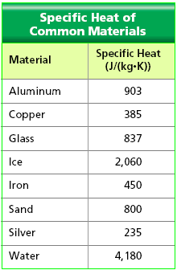
Specific heat of common objects
Which object has the greatest specific heat?
Which object has the lowest specific heat?
Which object would take the shortest amount of time to raise its’ temperature?
Which object would take the longest amount of time to raise its’ temperature?
Why doesn’t water freeze immediately the first day the temperature goes below freezing?

Slide 8
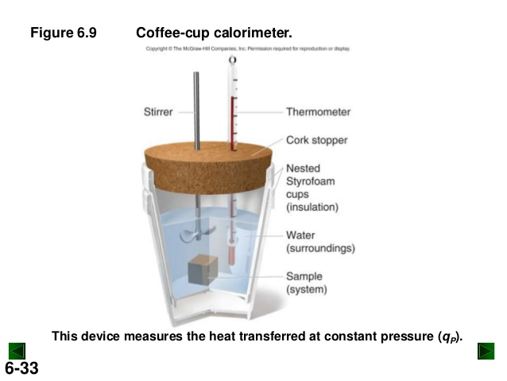
Measuring Specific Heat
Use a calorimeter
Need to know mass of object, temperature change and amount of heat absorbed or released
Place a heated sample into known mass of water
Amount of heat (thermal energy) gained by water is same amount of heat lost by object
Used to calculate specific heat of objects

