Slide 1
Nature of Energy
Chapter 4.1

Slide 2
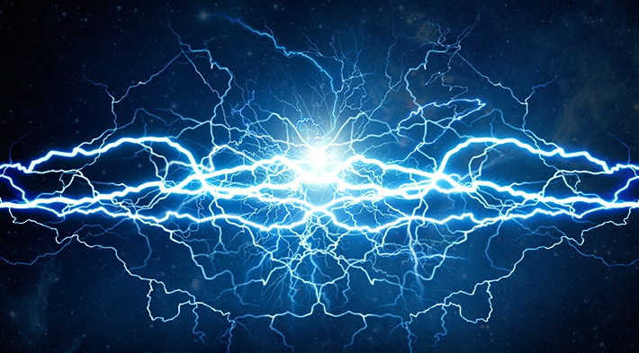
Energy
Not matter (no mass, doesn’t take up space)
Ability to do work or raise in temperature
Any change involves energy
Change in position
Change in chemical composition
Change in temperature

Slide 3
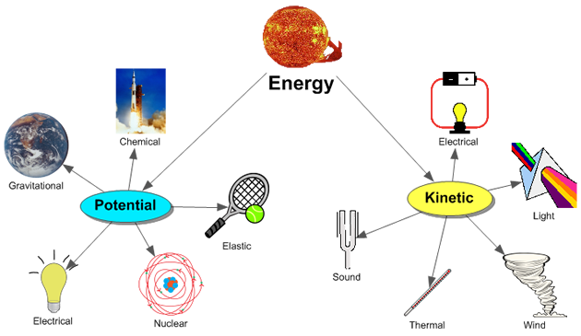
How many forms of energy can you list?

Slide 4
Different Forms of Energy
Electrical- movement of electrons
Chemical- making and breaking bonds in substances
Radiant- light
Thermal- heat

Slide 5
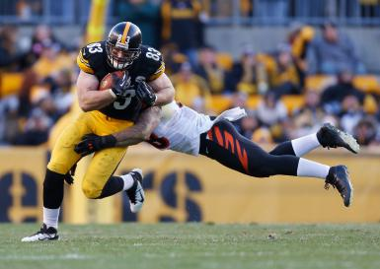
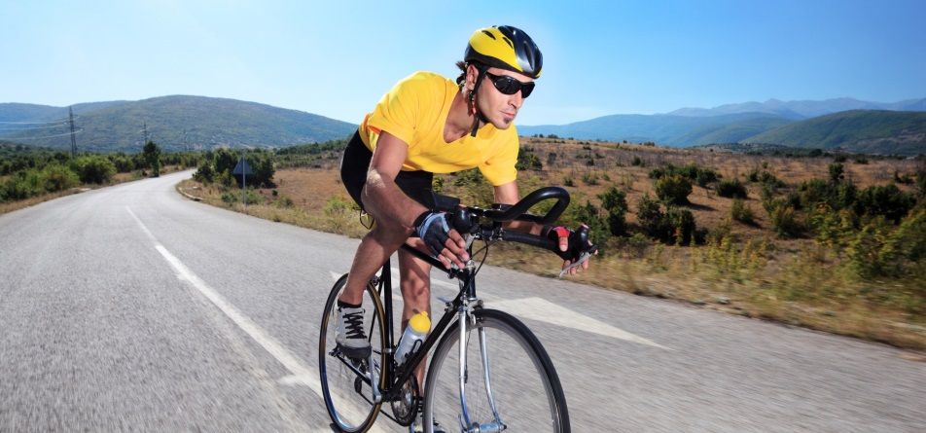
Kinetic Energy
Energy a moving object has because of its motion
Depends on objects mass and speed
Kinetic energy = 1/2mv²
SI Unit for Energy = Joule (J) = kgm²/s²

Slide 6
Practice Question 1
How much KE does a 2 kg object traveling 10 m/s have?
KE= 0.5mv²
KE= 0.5 (2) (10) ²
KE= 100 J

Slide 7
Practice Question 2
If a 5 m/s object has 100 J of KE, what must its mass be?
100 J = 0.5m(5) ²
m= 8 kg

Slide 8
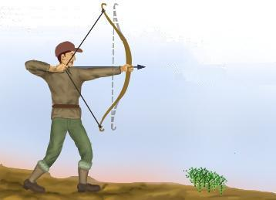
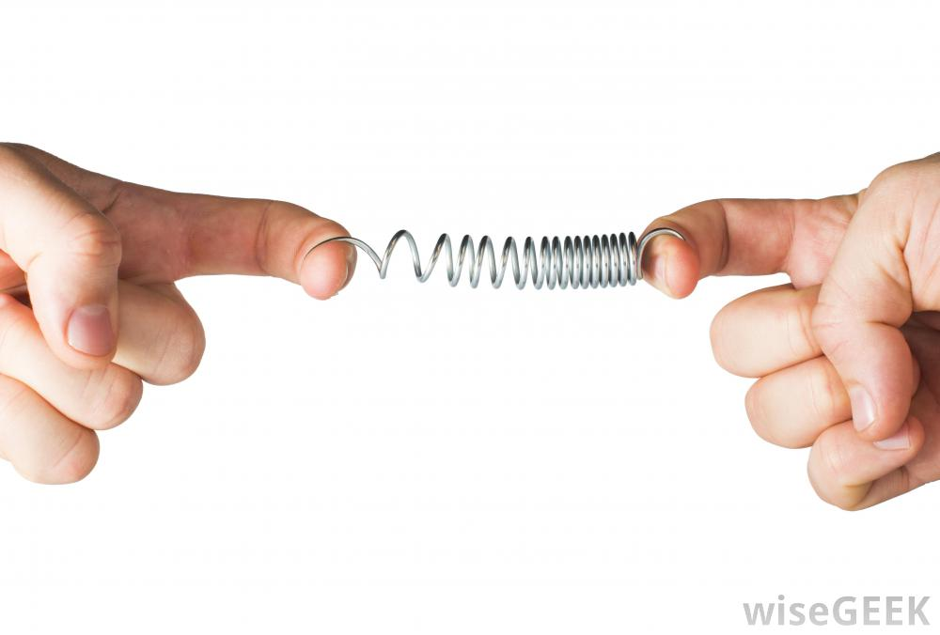
Potential Energy
Even motionless objects have energy
Energy is stored in the object
Has potential to cause change
Stored energy due to its position

Slide 9
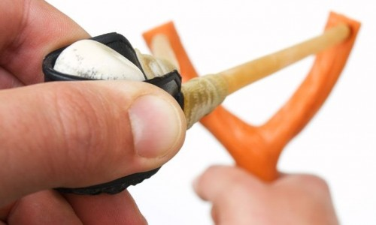
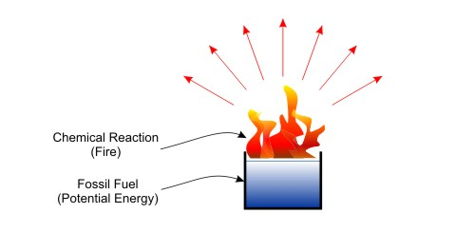
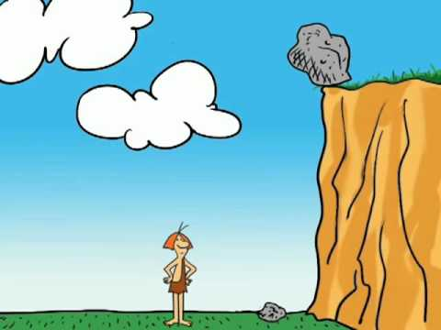
Different Forms of Potential Energy
Elastic potential energy
Energy stored in something that can compress or stretch
Examples: Springs, rubber bands
Chemical Potential Energy
Energy stored in chemical bonds
Gravitational Potential Energy
Energy stored by an object due to its position above Earth’s surface

Slide 10
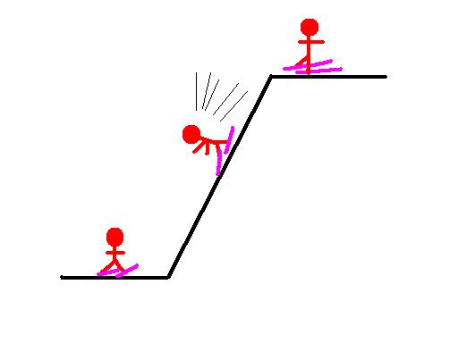
Gravitational Potential Energy
PE = mgh
PE = mass x acceleration due to gravity x height

Slide 11
Practice problem
How much energy does a 60 kg person have if they are on top of a rollercoaster hill 100 meters in the air?
PE = mgh
PE = 50 x 9.8 x 100
PE = 49,000 J

