Slide 1
Newton’s 3rd Law of Motion
Chapter 3.3

Slide 2
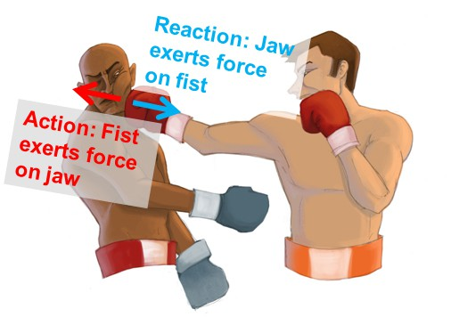
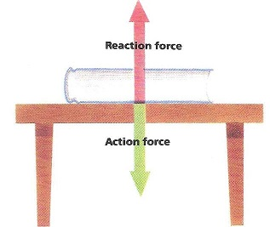
Newton’s 3rd Law of Motion
“Every action force has an equal but opposite reaction force”
Forces occur in pairs
Equal but opposite

Slide 3
Example:
If you exert a force on the chair you are sitting on, what is the reaction force?
the chair exerts an opposite but equal force on you.
Action: Object A exerts a force on object B.
Reaction: Object B exerts a force on object A.

Slide 4
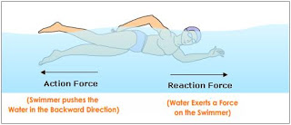
If the forces are equal but opposite how does motion occur?
The action and reaction forces act on different objects
Therefore, they are not balanced forces

Slide 5
Action and Reaction on Different Masses
While jumping, you exert the same force on the Earth as it does on you. Why, then, don’t you see the Earth move?
Answer:
F (you) = m*a = m*a = F (earth)
Since the masses of the two objects are unequal, their accelerations will be different. Therefore, the object with the smaller mass will move a larger distance than the larger object.

Slide 6
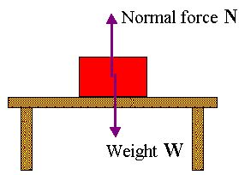
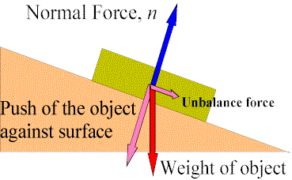
Diagramming Forces
Normal force
Force a surface exerts on an object
Always perpendicular to the surface

