Slide 1
Gravity
Chapter 3.2

Slide 2
What is Gravity?
Attractive force between 2 objects
Does not require direct contact
Depends on mass and distance between objects

Slide 3
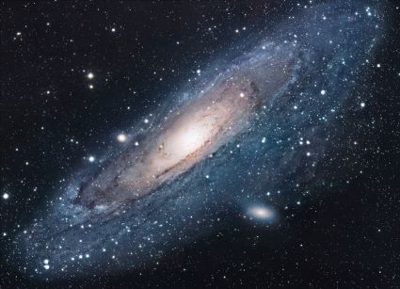
Gravity is Universal
Everything is influenced by gravity!
Every mass in the universe interacts with other objects and has gravity between them

Slide 4
Universal Gravitation Equation
F=Gm₁m₂
d²
As the distance increases between objects, the forces of attraction decrease
Force of gravity is inversely proportional to the square distance
The larger the masses, the greater the force of attraction.
Force of gravity is directly proportional to the masses of the objects

Slide 5
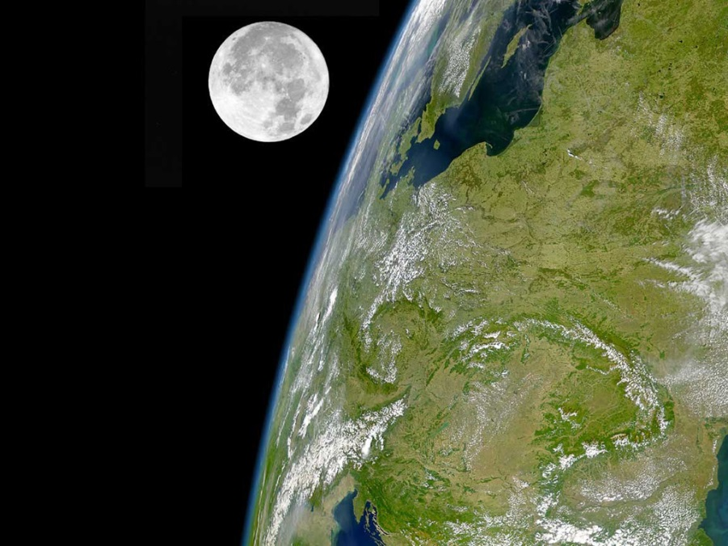
The greater the masses, the greater the force of attraction between them.
<

Slide 6
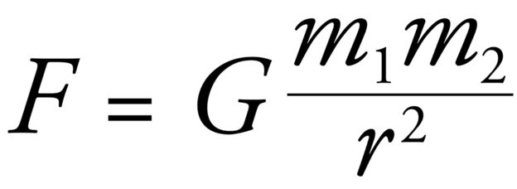
Gravitational Forces Concept Worksheet

Slide 7
Weight vs Mass
Mass
Amount of matter an object has
Measured in g or kg
Weight is the gravitational force exerted on an object
W= mg
Weight (gravitational force) = Mass x acceleration due to gravity
Measured in N
G = 9.8 m/s²

Slide 8
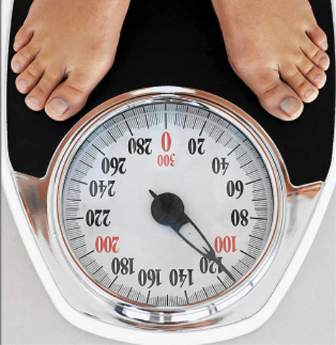
Why does an object weigh less in space than on Earth?
There is a greater distance between the center of the Earth and an object when it is in space then when it is on the surface of the earth. The smaller the distance between two objects, the greater the force of attraction.

Slide 9
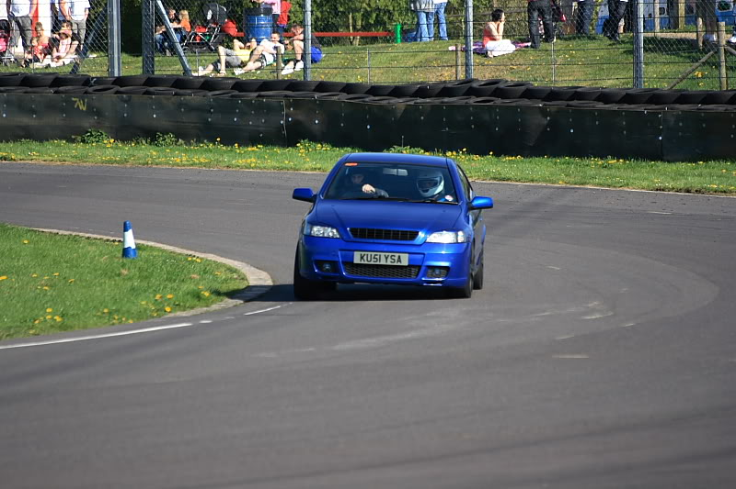
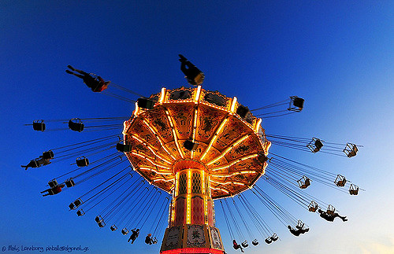
Circular Motion
Caused by a force that pulls an object inward
Otherwise it would fly off in a straight direction
Centripetal forces are inward forces for circular motion objects
What causes the centripetal force on the objects shown?

Slide 10
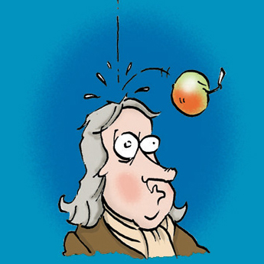
The Falling Apple
Newton is credited with discovering that gravity is universal.
He knew when the apple fell from the tree that an outside force must be acting on it (gravity!)

Slide 11
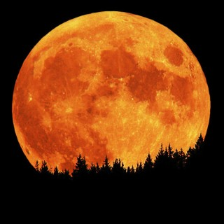
The Falling Moon?
Newton also noticed that the moon does not travel in a straight line but rather circular motion.
He knew that circular motion was caused by acceleration which requires a force.
Newton suggested that the moon is falling toward Earth and is also caused by gravity.

Slide 12
Without gravity, the moon would not orbit the Earth.
The moon must be traveling at a speed great enough for the moon to fall around the Earth rather than into it.
Without this speed the moon would travel in a straight motion into the Earth.

Slide 13
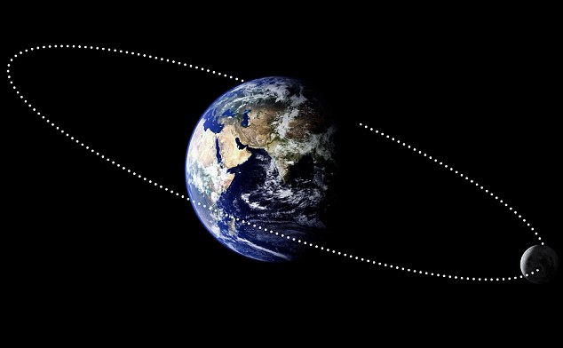
What is the centripetal force for this object?

Slide 14
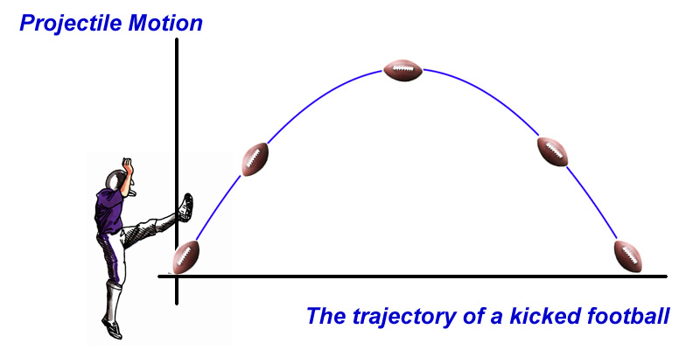
Projectile Motion
2-D Motion
Caused by initial force on object and by gravity
Gravity causes an unbalanced force which changes its direction

Slide 15
Circular Motion- Hammer Throw
https://www.youtube.com/watch?v=YfTUPvPMrh0
Projectile Motion- Javelin throw
https://www.youtube.com/watch?v=V3ONDGjFKtY
Linear Motion- Curling
https://www.youtube.com/watch?v=miB7HzUvmM0

