Slide 1
Behavior of Waves
Chapter 10.3

Slide 2
Reflection
Wave strikes an object and bounces off of it
All waves can reflect
Echoes
Light

Slide 3
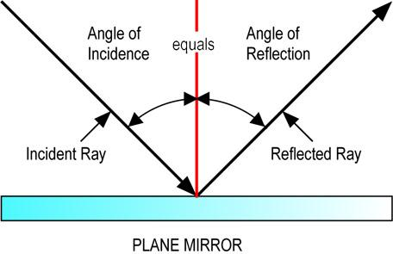
Law of Reflection
The angle of the incident wave (in) equals the angle of reflection (out)

Slide 4
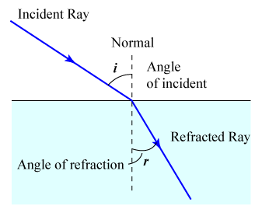
Refraction
Bending of a wave caused by a change in speed as it the wave moves from one medium to another

Slide 5
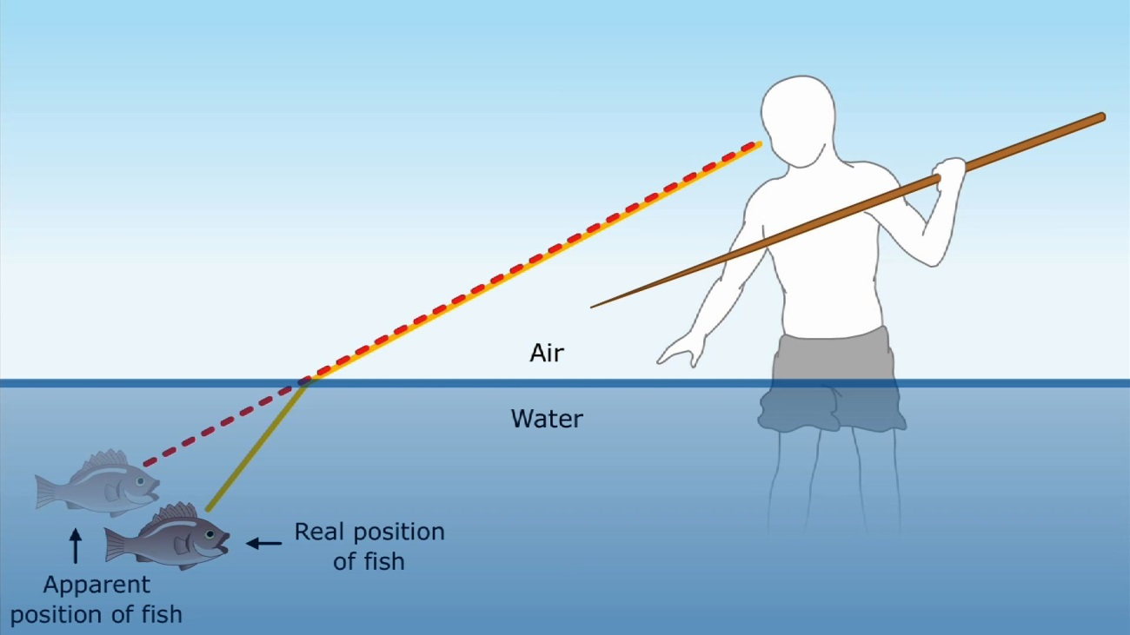
Refraction of Light
Light travels faster in air than water
When waves slow down they bend toward the normal
When waves speed up they bend away from the normal

Slide 6
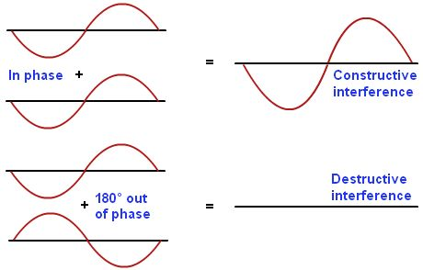
Interference
when two waves arrive at the same place at the same time, they combine to form a new wave
Constructive interference
Two waves add together, increases amplitude
Example: louder sound
Destructive interference
Two waves subtract from each other, decreases amplitude
Example: dead spots in auditoriums

